Slide 1
CITY OF MONTEREY AQUATIC CENTER
INNOVATIVE CREATION
DECEMBER 10, 2018

Slide 2
Project Management Agenda
Company Background
Scope
Risk
Procurement
Schedule
Cost
Quality
Communications
Human Resources
Q&A
Notes:
Company Background – Melissa
Scope – Melissa
Risk – Gilbert
Procurement – Gilbert
Schedule – Gilbert
Cost – Melissa
Quality – Leonard
Communications – Leonard
Human resources – Leonard
QA
With Ana
Company Background – Melissa
Scope – Melissa
Risk – Gilbert
Procurement – Gilbert
Schedule – Leo
Cost – Leo
Quality – Leo
Communications – Ana
Human resources – Ana
QA

Slide 3

Specialized in providing constructional and facility management services
Family owned and operated company
Over 30 years of experience in the Central region of California
High Rate of Customer Loyalty.
Awarded multiple project achievement awards from the Construction Management Association of America (CMAA)
Archaeology Research Facility at the University of California, Berkeley (2013 CMAA Project Achievement Award)
Notes:
Communication develops the relationships necessary for successful project and program outcomes.
Opening sentence: Good communication is an essential tool in achieving productivity and maintaining strong working relationship, so it is very critical to create an environment or the habit of communicating efficiently.
It is 90 percent of the project.
why is it so important(Barrier removers)
builds trust,
Common and consistent basis
Keep promised and meet expectations
Keep all stakeholders involved.
90% of the project
builds trust,
Good communication is an essential tool in achieving productivity and maintaining strong working relationships
We aim to communicate before being asked to.
Good Communication builds good teams
builds trust and confidence between the two, and also strengthens the effectiveness of our team
You can prevent misunderstandings with good communication.
Deliver and convey the right message
Customer service relies on good communication
Positive relationships, influence, control perception
Good communication skills will help you achieve
Control the outcome
We encourage and support involvement of our stakeholders.
Deliver and convey right message
Influence
Control the outcome
Effectiveness of team
Trust and confidence
Positive relationships
Control perceptionnn

Slide 4
Organization
Quality Assurance Manager
Leonard Newman
Construction Manager
Gilbert Benavidez
Project Manager
Melissa Cortez
Resource Manager
Analisa Ramirez

Slide 5
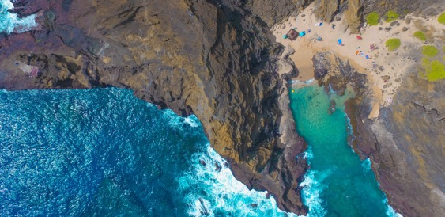
Scope
Innovative Creations will construct a pool, spa, and facilities area in the City of Monterey because there’s no public swimming facility within 10 miles other than the facility in Seaside, CA. It shall offer a tourist attraction to entertain 7.8 million in addition to annual visitors. It will not only be a recreation venue for Monterey residences, but it will also allow the residences to learn about the native plants and historical aspects of the area.
Deliverables
Pool - 50’ x 125’ pool with ladders, handicapped access, heating system, tile/non-skid coping design to match city heritage, two lifeguard stations
Spa - One medium size spa with a capacity of up to 15 people, Spa with ingress and egress
Parking lot - 100 vehicles, 20 bike racks
Landscaping - Parking lot and around facility, consistent with plant life/landscape of Monterey-Carmel Peninsula
Lighting - Pool, parking lot area, energy efficient
Facilities - Administration building at entrance, vendor area, building to house filtration, cleaning, heating systems. Bath/changing rooms for 25-50 people. Cinder block and chain link fence with gates
Historical Requirements - Building codes consistent with architectural style of Monterey historical era

Slide 6
Risk Management
Project Management
External
City permits not being obtained timely
Lack of team working on project and them pursuing their own agendas
Delay due to design changes
Unexpected increases in material costs
Damaging magnitude earthquake
Poor quality workmanship from landscaping contractor
Late material delivery
Complaints from public during construction
Subcontractors do not complete assignments
Notes:
Probability Impact Matrix
And
Risk Register

Slide 7
Risk Management
Risk Register
Risks Probability Impact Matrix
Rank | Risk | Category | Response | Response Type
R1 | Resignation of PM | Project Management | Backup PM | Mitigate
R2 | Unexpected Increases in Material Costs | External | Management Budget | Mitigate
R3 | Damaging magnitude earthquake | External | Insurance | Transfer
R4 | Poor quality workmanship from landscaping contractor | External | Quality Assurance to have weekly reviews | Mitigate
Minor issues; no schedule impact
Minor issues; workaround avail, no impact
Major issues; no work around; schedule impact
 | Impact
Probability (1-3) | 3 |  |  | R6, R10
 | 2 |  | R4, R5 | R7, R8, R9
 | 1 |  | R1, R2 | R3
 |  | 1 | 2 | 3

Slide 8

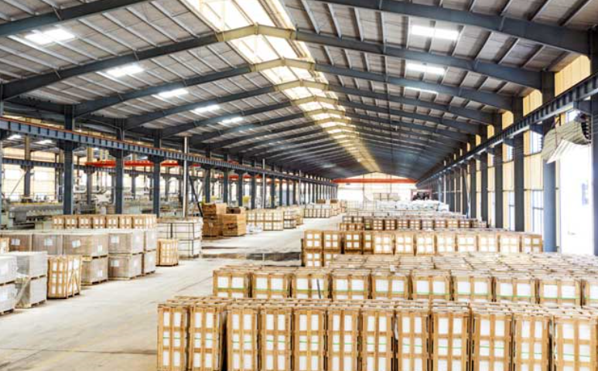

Procurement
Construction Committee is responsible for procurement
Material is purchased in advance to lock in the best rate
Materials must be procured through approved vendors list
Materials are stored in 30k sq. ft. warehouse

Slide 9
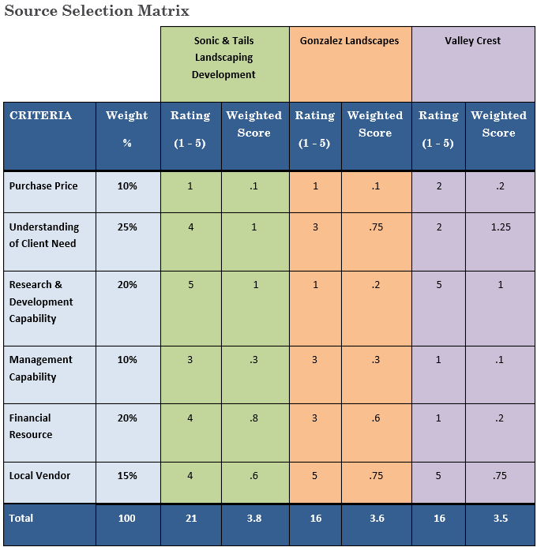
Procurement
Vendor selection for landscape

Slide 10
Schedule Management
Strategy
To estimate costs (labor costs) the project team used:
Researched published commercial information
The team worked with the scope baseline and the project schedule along with approved WBS to estimate costs.
Contingency reserves has been added based off of the risk register prob/impact matrix
Approach
Hybrid method:
Expert judgement: Industry information, similar projects and knowledge area
Cost Aggregation: cost estimates are aggregated by work packages in accordance with the WBS
Threshold
Performance Measure | Yellow | Red
Schedule Performance Index (SPI) | Between 0.9 and 0.6 or Between 1.1 and 1.4 | Less Than or Equal to 0.5 or Greater than or Equal to 1.5

Slide 11
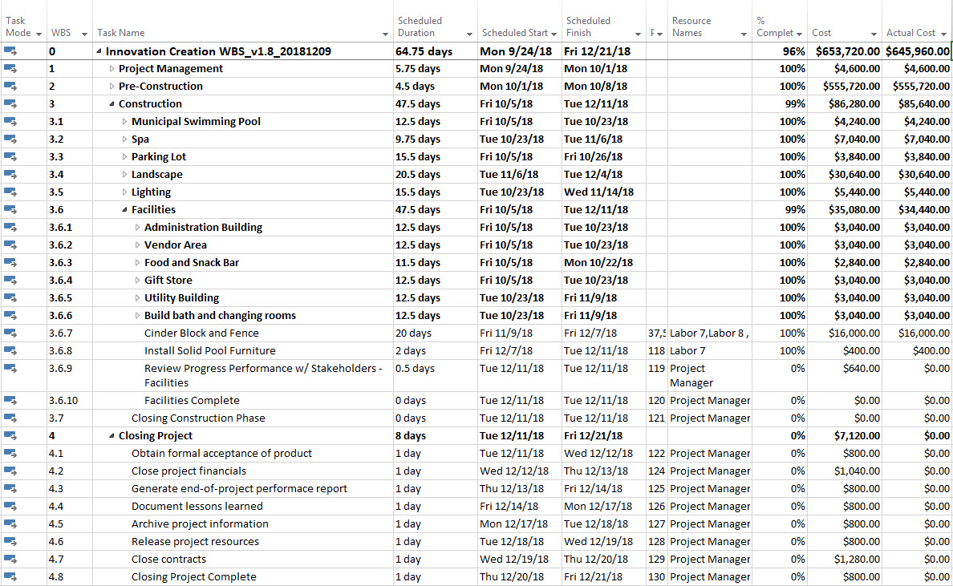
Schedule Management
Scheduling Tool
Project planning with Microsoft Project
Precedence Diagramming Method (PDM)
Mostly Finish to Start
Project Completion Date is December 21, 2018
Schedule is on track

Slide 12
Cost Management
Project is 96% completed as of December 11
Total Planned Budget = $650,840
Actual Cost = $579,320
CPI Threshold
Acceptable Threshold for the CPI = (-/+) 0.5
Materials market fluctuations
Increasing labor costs
Reserves
Contingency Reserve= 5%
Management Reserve= 7%

Slide 13
Cost Management
EV = $653,720 (BAC) * 96% (Actual % Complete) = $627,571.20
PV = $653,720 (BAC) * 96% (Planned % Complete) = $627,571.20
CPI = $627,571.20 (EV) / $645,960 (AC) = .97
SPI = $627,571.20 (EV) / $627,571.20 (PV) = 1
CV = $627,571.20 (EV) - $645,960 (AC) = -$18,388.8
SV = $627,571.20 (EV) - 627,571.20(PV) = $0
EAC = $653,720 (BAC) / 0.97 (CPI) = $673,938.14
ETC =$673,938.14 (EAC) - $645,960 (AC) = $27,978.14
Within budget
CPI=.97
Right on schedule
SPI=1

Slide 14
Quality Management Quality Process
Quality Planning
Sponsor Acceptance Criteria
City Permits and Inspection
ASTM (American Society for Testing and Materials) Approved
Approved Vendor List – Sonic and Tails landscaping Development
Quality Assurance Team
3rd Party Audit to meet ISO 9001 Certified
Perform Quality Assurance
Project Manager
Quality Assurance
3rd Party Auditor
Perform Quality Control
QA and 3rd Party Auditor for Audit and Review
Thorough Assessment for each stage, milestone, and phase based off the sponsors requirements and specifications.

Slide 15
Quality Management Quality Assurance
Product | Physical/Performance Standards | Quality Assessment Activities | Assessment Intervals
Municipal Swimming Pool | One pool to be built 50’ x 125’ | Lab and field testing | Per Completion of each sub-phase
 | Depth starting at 3’ and increasing to 12’
 | Eight ladders with hand bars spaced around the pool
 | Handicapped access both 3’ and 12’ ends of the pool
 | State of the art pool heating system
 | Tile and non-skid coping designed to blend with the image and heritage of the Monterey-Carmel Peninsula
 | Two appropriately equipped lifeguard stations for the large pool and handicapped area
Spa | One medium size spa with a capacity of up to 15 people | Lab and field testing | Per Completion of each sub-phase
 | Handicapped access
 | Spa with ingress and egress
 | State of the art pool heating system
 | Tile and non-skid coping designed to blend with the image and heritage of the Monterey-Carmel Peninsula
 | One lifeguard station for the spa and handicapped area
Parking Lot | To accommodate 100 vehicles | Lab and field testing | Per Completion of each sub-phase
 | Contain bicycle rack for 20 bicycles
Landscaping | Landscaping in the parking lot and around the entire facility | Lab and field testing | Per Completion of each sub-phase
 | Landscaping to be consistent with the plant life and surrounding landscape of the Monterey-Carmel Peninsula
Lighting | Complete lighting of the pool area inside pool included) | Lab and field testing | Per Completion of each sub-phase
 | Complete lighting of the parking lot area
 | All lighting to be energy efficient lighting
Facilities (Design and construction Only) | Administration building located at the entrance | Lab and field testing | Per Completion of each sub-phase
 | Office for collection of entry fee
 | Security office
 | Administrative office
 | Vendor area (two 15’ x 45’ areas with electrical, plumbing, and heating)
 | Food and snack bar
 | Gift store
 | Utility building to house pool filtration, cleaning and heating systems
 | Cinder block and chain link fence with gates to surround the swimming area, administrative building, and utility building
 | Solid pool furniture
 | Chairs and Tables for 50-100 people
 | Bath/changing rooms to accommodate 25-50 people
Historical Monterey Requirement | Building codes to be consistent with and reflect the historical nature of the early Monterey era with “Spanish Colonial” style of architecture | Lab and field testing | Per Completion of each sub-phase
 | Tan or Beige stucco for walls, antique styled terracotta roof tiles
 | Plant life to be consistent with the native flora of the city. This will include both Cypress and Pine trees arranged in terra cotta planters

Slide 16

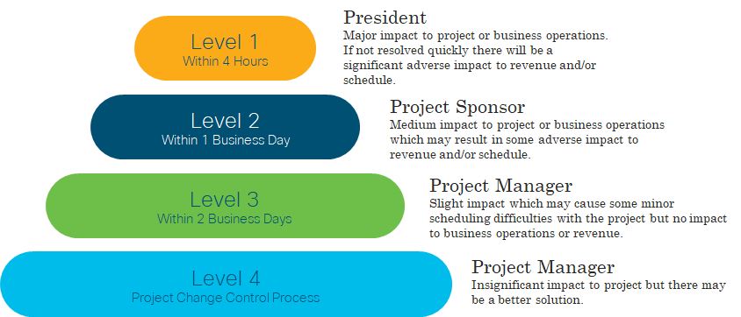

Communication Management
Escalation Process
CRM Application: Project Portal
Performance reports
Deliverable status
Schedule progress
Budget
Weekly Meetings with Stakeholders
Guidelines and Agendas
Face-to-Face, phone calls, emails
Meetings Notes and Reports
Notes:
Weekly Meeting with Stakeholders
Guidelines for meetings
Agenda for meetings
Project Reporting
Project Portal (Weekly)
Performance reports
Deliverable status
Schedule progress
Cost incurred
Other information required
which offers opportunity to engage with stakeholders and form online communities.
With Project Portal we can share our Project reporting.
Project Reporting
· The act of collecting and distributing project information.
o Distributed and adapted for each stakeholder, at an appropriate-level, format and detail

Slide 17
Communication Management Communication Matrix
The following table identifies the communications requirements for this project.
 | Project Manager | Project Sponsor | Contractor | Designer | Landscaping Development
Project Charter | C | A | R | R | R
Communication Management Plan | C | A | R | R | R
Business Requirements | R | A | R | R | R
Status Report | C | R | A | R | R
Landscaping Deliverable | A | A | R | R | C
Key:
A - Approves/Accepts
R - Reviews the deliverable
C -Creates/Produces the deliverable

Slide 18
Communication Management Project Team Directory
Role | Name | Title | Department | Email | Phone
Project Sponsor | Bob White | Mayor of Monterey | City of Monterey | bobwhi@cityofmonterey.com | 714-111-2222
Project Manager | Melissa C. | Project Manager | Project Management | leonew@innovative.com | 714-555-7777
Construction Manager | Gilbert B. | Manager | Construction Committee | gilbertb@innovative.com | 714-122-2234
Human Resource Manager | Analisa R. | Manager | Human Resources | Analisar@innovative.com | 714-299-6666
Designer | Monica P. | Designer I | Design | monpad@innovative.com | 714-555-7789
Contractor | Bill R. | Senior Contractor | Construction Committee | bilrod@innovative.com | 714-555-7745
President | President Gate | President | Owner | presidentoffice@innovative.com | 714-666-9999

Slide 19

Human Resources
Project Team
Qualified team
All team members are crossed trained
Qualified suppliers from our approved vendor list
Performance Review:
Project Manager with Construction Committee
Above Satisfactory
Notes:
Our Project manager will have weekly reviews with the project team to ensure activities are performed as expected. The project manager, with the assistance of the contractor, will ensure team members are performing effectively and completing assigned work with quality and in a timely manner. Prior to closing out the project and releasing the team to future projects, the project manager will meet with the construction committee to provide feedback on performance. The construction committee will then work with each individual laborer regarding performance review

Slide 20
Human Resources RACI Chart
 | Project Manager | Designer | Contractor | Laborer | Landscaping Development
Requirements Gathering | A | I | I | - | I
Design Plan | A | R | I | I | I
Construction Deliverables | A | - | A/R/C | R | -
Landscaping Deliverables | A/C | - | I | - | R/C
Completion of Project | A/I | - | R | R | R
Key:
R - Responsible
A - Accountable
C - Consulted
I - Informed
Roles and responsibility within project task and resources
Proposed changes were reviewed and approved.
Notes:
Raci chart
Project Manager, (1 Position): responsible for gathering requirements. Have weekly check-ups on pool construction to ensure timelines are met. The PM is responsible for ensuring quality control of our landscaping subcontractor and our internal resources. The PM will communicate performance of everyone’s tasks according to our communication plan. Our PM has over 5 years of project managing for a development company with the following skills: leadership, budgeting, punctuality, strong communication, and deadline and detail-oriented.
Designer, (1 Position): responsible for identifying the clients needs and putting together a feasible design proposal. The Designer is also responsible for developing a plan that is carried out to specific standards, building codes, guidelines and regulations. Our designer has proven work experience, strong portfolio of design skills, and has expert knowledge of building products, construction details, and relevant regulation.
Contractor, (1 Position): responsible for overseeing the building of pools and buildings. The contractor is also responsible for coordinating with our electricians, plumbers, and our internal laborers; and obtaining appropriate material to complete the project successfully. Our contractor has over 10 years of experience and will ensure all necessary permits are acquired, ensure all quality work is completed on time, ensure all inspections are schedule in coordination with the PM, and will help work to maintain project budget and communicate status to client and PM as stated in communication plan.
Laborer, (10 Positions): responsible for installing swimming pools, spas, and constructing buildings. The laborer has the ability to do carpentry, electrical work, plumbing and other specialized skills required by our contractor. Our laborers have over 3 years of experience on construction crews, have a willingness to learn, and can complete work on time and on budget with minimal supervision.
Landscaping Development, (1 Position): responsible for meeting with us (the client) to develop plans for our project. The landscaping subcontractor is local and familiar with the heritage of the Monterey-Carmel Peninsula. With over 10 years of experience, they will be responsible for creating an outdoor space by planning trees, flowers, lawns, and/or paths based off of project requirements. The subcontractor will be responsible for maintaining project budget and communicating status to the PM as stated in communication plan.

Slide 21
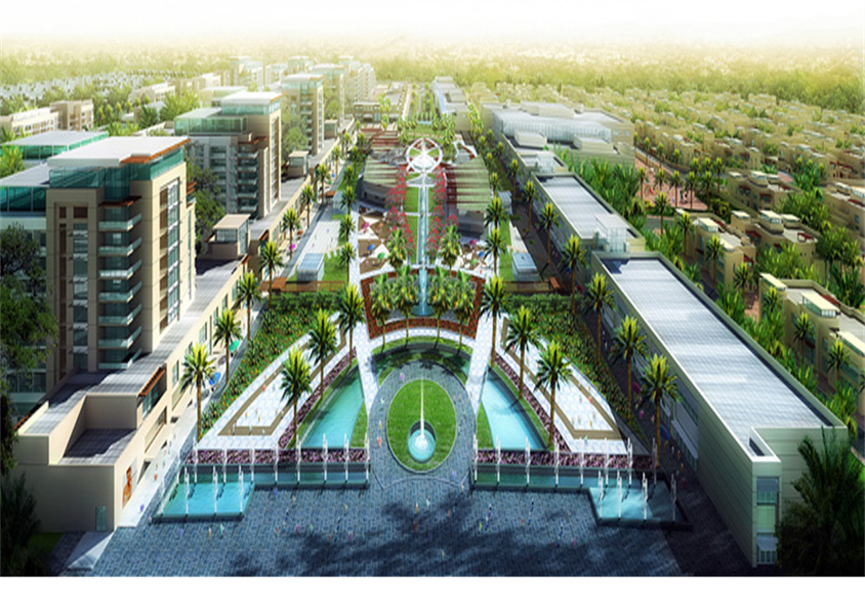
Questions?

